Slide 1







CLOUD ENGINEERING SPECIALIZATION
Tech Skills Accelerator
NOUN MIS Modernization
Bittome Nwokealisi

Slide 2
0
Business Overview
NOUN MIS: Cost Optimization, Performance Improvement, Migration
TESA
Cloud Engineering

Slide 3
ORGANIZATION OVERVIEW
Overall Business Goals and Primary Concerns
About NOUN
The National Open University of Nigeria is a federal open and distance learning institution.
NOUN operates a Management Information System (MIS) application for student registration and records management. This application handles various student documents including:
• Personal identification (passport photographs and ID - 2 per student)
• Academic certificates and credentials (approximately 7 per student)
• Various PDF documents
Cloud Infrastructure Goals
Migration of NOUN MIS infrastructure from BlueHost to AWS Cloud with the following considerations and justifications:
Improves application response times
Cost-efficient storage solution
Handle peak loads efficiently during registration periods
Scalable solution for future growth
TESA
Cloud Engineering
3

Slide 4
1
Architecture Requirements
Current Infrastructure architecture | Key Challenges | Causes
TESA
Cloud Engineering

Slide 5


ARCHITECTURE REQUIREMENTS
Current Infrastructure Architecture
NOUN employs a traditional single-server deployment on Bluehost that houses:
• The MIS web application
• Database system
• Document storage (approximately 153,000 files: 34,000 photographs and 119,000
certificates)
TESA
Cloud Engineering
5

Slide 6





ARCHITECTURE REQUIREMENTS
Key Challenges
Slow application response times (peak periods)
Sluggish document retrieval and processing
Limited scalability with growing population
Inefficient Storage Costs
Increasing costs without improvements
TESA
Cloud Engineering
6

Slide 7
ARCHITECTURE REQUIREMENTS
Causes of Bottlenecks
MONOLITHIC SINGLE SERVER:
One overloaded machine handling all requests like 5000 logging in and 4000 uploading docs.
NO AUTO-SCALING:
Cannot expand resources dynamically based on traffic or requests when traffic spikes.
SLOW DOCUMENT RETRIEVAL:
Files are stored on traditional disk-based storage, which isn't optimized for high read operations, unlike a dedicated service like S3.
EXPENSIVE SCALING:
The monolithic architecture makes scaling expensive because they would need to provision an entire server to scale
INEFFICIENT STORAGE COSTS
Scaling can’t be done on individual resources like storage and compute making additional storage expensive to purchase
HIGH MAINTENANCE OVERHEAD:
For example; IT team constantly troubleshooting slow queries instead of improving features.
P E R F O R M A N C E
C O S T
TESA
Cloud Engineering
7

Slide 8
2
Solutions Architecture
Implemented Solution | Proposed Architecture | Justification
TESA
Cloud Engineering

Slide 9
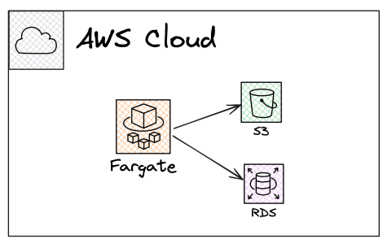
Solutions Architecture
Implemented Solution
Frontend & Backend: Monolithic, running on AWS Fargate.
Storage: Images and PDFs moved to Amazon S3
Database: Moved to AWS RDS for better scalability and performance.
TESA
Cloud Engineering
9

Slide 10
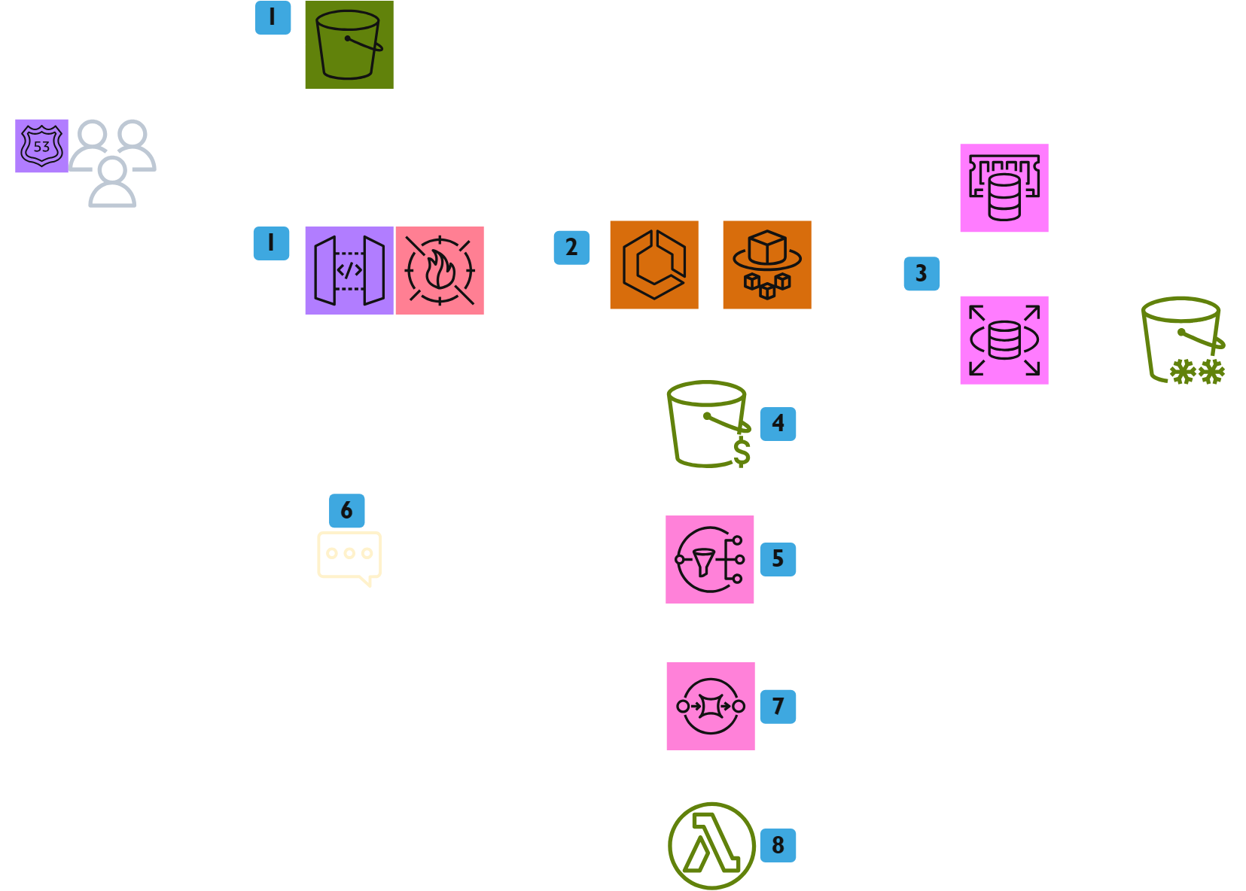
SOLUTIONS ARCHITECTURE
Proposed Architecture: Flow diagram
TESA
Cloud Engineering
10

Slide 11
SOLUTIONS ARCHITECTURE
Proposed Architecture: Flow diagram
NOTES:
The solution shown proposes a decoupling of the static frontend components from the backend, using S3 to host the frontend and a serverless container solution to handle the backend
Web requests for MIS application are routed through the internet and hit S3 for static web contents. As for logging in, document uploads, database updates, and file processing, the API gateway is the entry point
A Web Application Firewall sits behind the Application GW to scan incoming web based traffic and provide security.
ECS holds the backend container code and spins up Fargate instances upon request. It scales based on demand using metrics from CloudWatch
For uploads and dB updates, the Elasticache service is the first query point before the main database to enhance query speed
TESA
Cloud Engineering
11

Slide 12
SOLUTIONS ARCHITECTURE
Proposed Architecture: Flow diagram
NOTES:
After the database has confirmed the identity of the user logged in, the are granted permission to upload or read documents from S3. S3 uploads are done by giving the user a pre signed URL with an expiration time of 10 mins to ensure security of bucket.
For uploads, once the file is uploaded, an S3 event notification is sent to SNS.
SNS does two things; adds file processing job to an SQS queue and sends notification to user to log out upon successful upload
Lambda (triggered by SQS) processes file and updates RDS with file path and status.
There are 3 S3 buckers deployed: “MIS Frontend” (Standard class), “Active Student Docs” (Intelligent Tiering with Policy to Archive after one year), “Past Student Archive” (Glacier Deep Archive Class)
Key architecture goal drivers: Performance, Cost optimization, Scalability.
TESA
Cloud Engineering
12

Slide 13
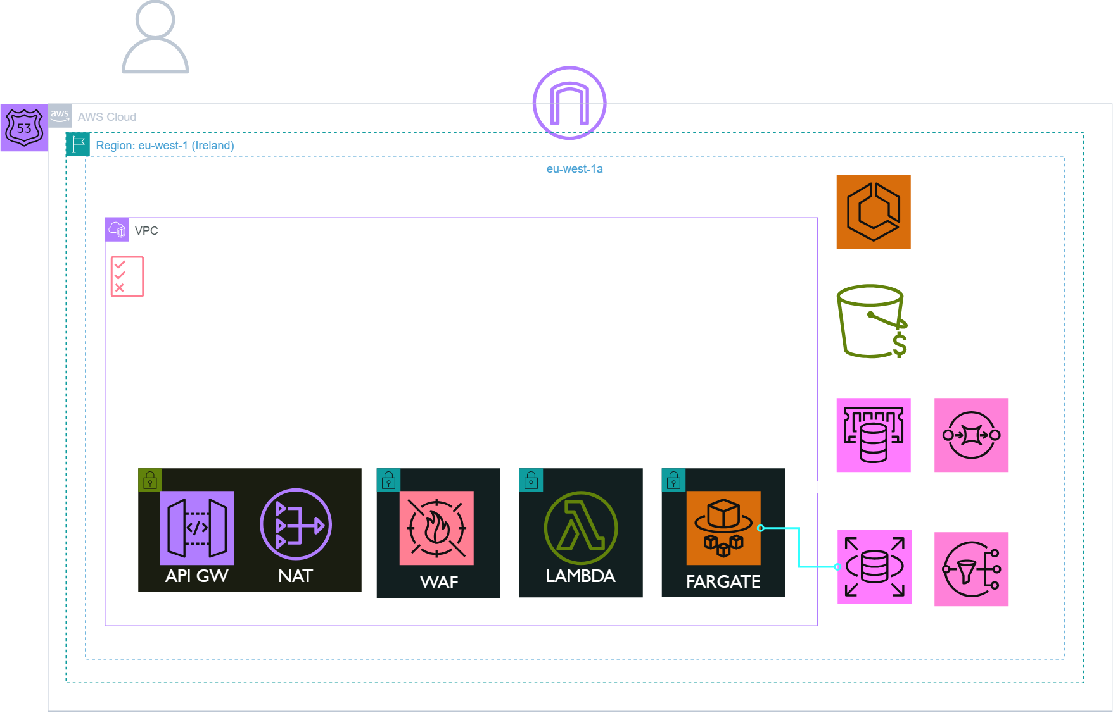
SOLUTIONS ARCHITECTURE
Proposed Architecture: Network Architecture
NOTES:
Performance:
2. Managed services – AWS Fargate
3. Managed services – AWS S3
4. Managed services – AWS API GW
5.Managed services – AWS RDS
6.Managed services – AWS ELASTICACHE
Cost Optimization:
1.Serverless: Fargate & Lambda
2.S3 Lifecycle Policies
Scalability:
1.Fanout: SQS+SNS for upload traffic spike and high DB write requests.
2. Elasticache for fast queries
Security:
1. Access Control – IAM
2. Encryption – TLS, S3 Pre-Signed URL
3. Routing
TESA
Cloud Engineering
13

Slide 14
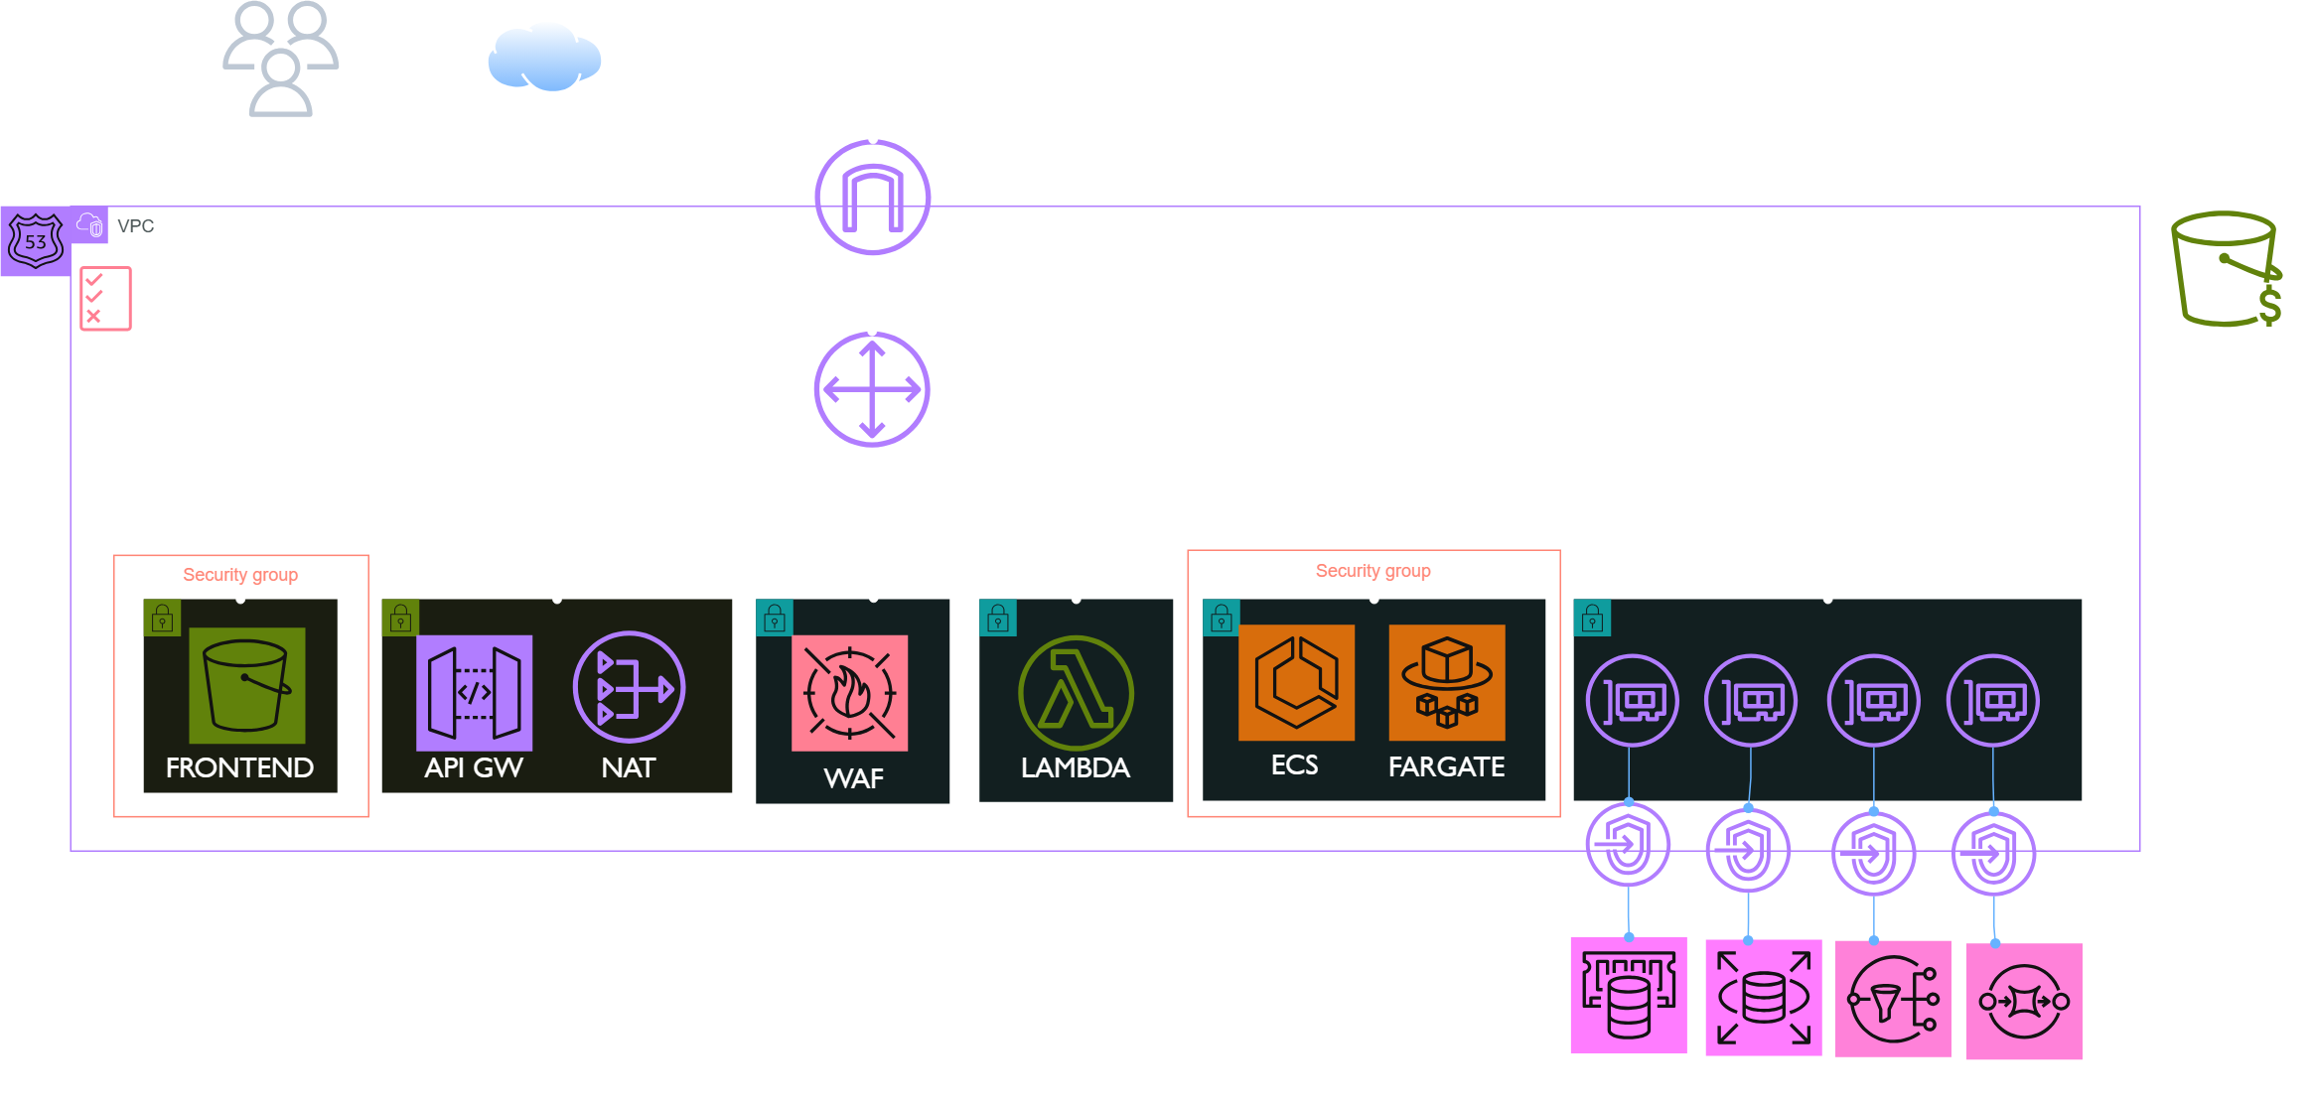
SOLUTIONS ARCHITECTURE
Proposed Architecture: Network Diagram
TESA
Cloud Engineering
14

Slide 15
DECISION RECORDS
RECORD #1: DECOUPLING FRONTEND AND HOSTING ON S3
DECISION
Decoupling the frontend from the backend reduces Fargate costs by preventing unnecessary compute usage for simple webpage views. It also lowers API Gateway expenses by offloading static content delivery to S3. S3 is a cost-effective, resilient solution that efficiently handles high traffic without scaling concerns.
CONSEQUENCES
While it reduces infrastructure costs, it requires Route 53 for custom domains and HTTPS support.
CONTEXT | COST PERFORMANCE
TRADE-OFFS | NEED FOR S3 FOR CUSTOM DOMAINS
RESOURCES | AWS S3 .
TESA
Cloud Engineering
15

Slide 16
DECISION RECORDS
RECORD #2: API GATEWAY + WAF
DECISION
API GW acts as a single entry point, simplifying routing, authentication, and request handling. WAF Protects against common web exploits (SQL injection, XSS, DDoS) and enhances API security. Deployed in Public Subnet as internet facing for public access
CONSEQUENCES
Adds a minor latency overhead but improves security, monitoring, and scalability. Adds operational cost but significantly reduces security risks.
CONTEXT | PERFORMANCE SECURITY
TRADE-OFFS | MINOR COST
RESOURCES | AWS API GATEWAY WEB APP FIREWALL
TESA
Cloud Engineering
16

Slide 17
DECISION RECORDS
RECORD #3: SERVERLESS BACKEND CONTAINERS
DECISION
Provides scalable, serverless compute without managing infrastructure, reducing maintenance overhead. Also allows to migrate base PHP code from BlueHost with minimal changes thanks to containerization Deployed in Private Subnet for security
CONSEQUENCES
Higher cost compared to EC2 in always-on workloads, but better for unpredictable traffic.
CONTEXT | PERFORMANCE .
TRADE-OFFS | HIGH COST AT PEAK PERIODS
RESOURCES | AWS ECS AWS FARGATE
TESA
Cloud Engineering
17

Slide 18
DECISION RECORDS
RECORD #4: S3 INTELLIGENT TIERING (FOR MAIN OBJECT STORAGE)
DECISION
Reduces storage costs by automatically moving infrequently accessed files to lower-cost tiers. Resilient storage option for high upload requests S3 event notification alerts SNS to process files and update DB while users move on. S3 pre-signed URL to ensure user has permanent access LifeCycle Policy is implemented to shift one year old objects to Glacier and 3 year old objects to Glacier Deep Archive
CONSEQUENCES
Slight retrieval delay for archived objects but optimizes long-term storage expenses.
CONTEXT | COST PERFORMANCE
TRADE-OFFS | - -
RESOURCES | AWS S3 .
TESA
Cloud Engineering
18

Slide 19
DECISION RECORDS
RECORD #5: LAMBDA FUNCTION
DECISION
Lambda processes jobs asynchronously, then updates RDS with file path and status. Deployed in Private Subnet for security
CONSEQUENCES
Execution time limits apply, so not suitable for long-running tasks. But has been offset but using a buffer
CONTEXT | PERFORMANCE COST
TRADE-OFFS | - -
RESOURCES | AWS LAMBDA -
TESA
Cloud Engineering
19

Slide 20
DECISION RECORDS
RECORD #6: RDS + ELASTICACHE
DECISION
RDS provides managed relational database and is Single AZ with Manual DB Snapshots to save costs. Elasticache speeds up database queries by caching frequent read requests, reducing RDS load.
CONSEQUENCES
Single AZ reduces failover capability but lowers costs compared to Multi-AZ. Elasticache adds extra memory costs but significantly improves application performance.
CONTEXT | PERFORMANCE RELIABILITY
TRADE-OFFS | COST -
RESOURCES | AWS RDS AMAZON ELASTICACHE
TESA
Cloud Engineering
20

Slide 21
DECISION RECORDS
RECORD #7: ROUTE53
DECISION
Route 53 provides custom domains for S3 and API Gateway, improving user experience with branded URLs. It enables traffic routing and failover strategies, ensuring high availability.
CONSEQUENCES
Route 53 incurs additional costs for hosted zones and queries. It also requires proper configuration to avoid misrouting traffic. Additionally, DNS changes may take time to propagate, causing brief delays during cutovers.
CONTEXT | PERFORMANCE RELIABILITY
TRADE-OFFS | - -
RESOURCES | AWS ROUTE53 -
TESA
Cloud Engineering
21

Slide 22
DECISION RECORDS
RECORD #8: IAM RESOURCE BASED POLICIES
DECISION
To ensure access control and security. Enforces fine-grained access control by defining permissions directly on AWS resources like S3, Lambda, and SNS, reducing reliance on IAM roles for every user or service.
CONSEQUENCES
Can become complex to manage across multiple resources and may lead to unintended access if not properly configured.
CONTEXT | SECURITY OPERATIONAL EXCELLENCE
TRADE-OFFS | CONFIGURATION COMPLEXITY
RESOURCES | AWS IAM -
TESA
Cloud Engineering
22

Slide 23
3
Migration Plan
Database Synchronization | Storage Synchronization | Cutover Strategy
TESA
Cloud Engineering

Slide 24
MIGRATION PLAN
PHASE DESCRIPTION
Database Sync
Storage Sync
Business Logic Cutover
DNS Cutover
TESA
Cloud Engineering
24

Slide 25
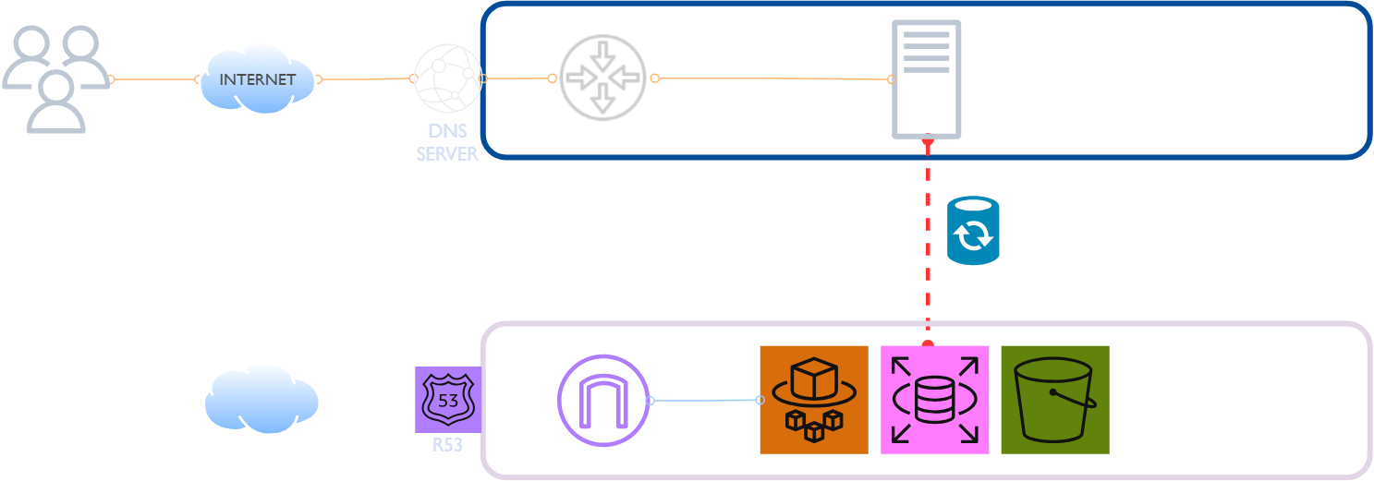

PRE-MIGRATION
DATABASE SYNCHRONIZATION
NOTES:
Set up AWS DMS (Database Migration Service) to replicate data from Bluehost’s database to RDS in near real-time.
Enable CDC (Change Data Capture) to keep RDS up-to-date.
Run checksums to ensure RDS matches Bluehost’s DB.
Perform test queries on both DBs.
Freeze writes on Bluehost DB (maintenance mode).
Switch application DB config to RDS.
Confirm all new writes hit RDS only.
TESA
Cloud Engineering
25

Slide 26
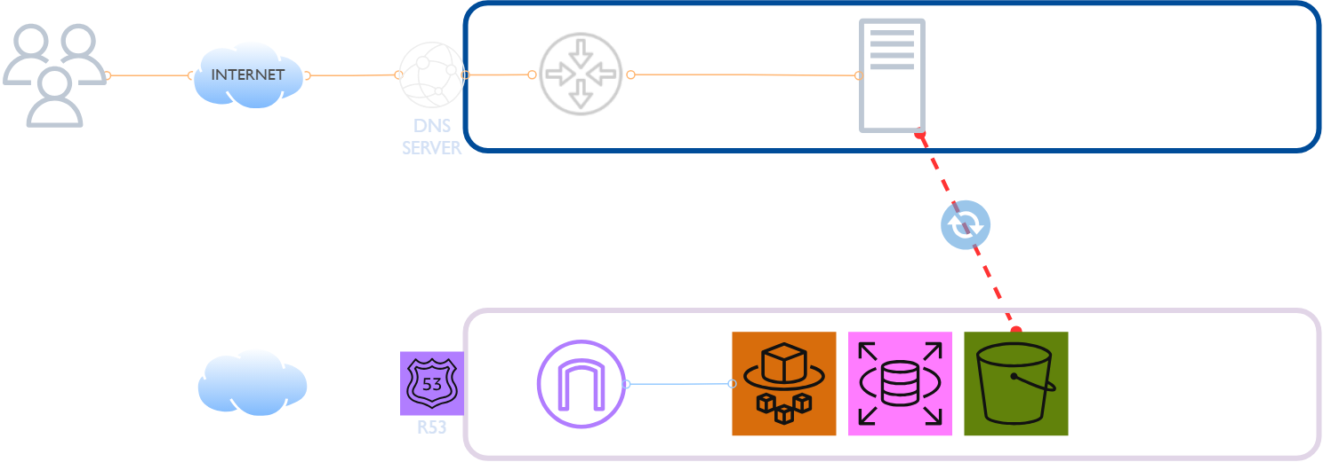
PRE-MIGRATION
OBJECT STORAGE SYNCHRONIZATION
NOTES:
Use AWS DataSync to copy existing files to S3
Modify the PHP app to read/write files from S3 instead of Bluehost storage.
Validate file access from S3.
TESA
Cloud Engineering
26

Slide 27
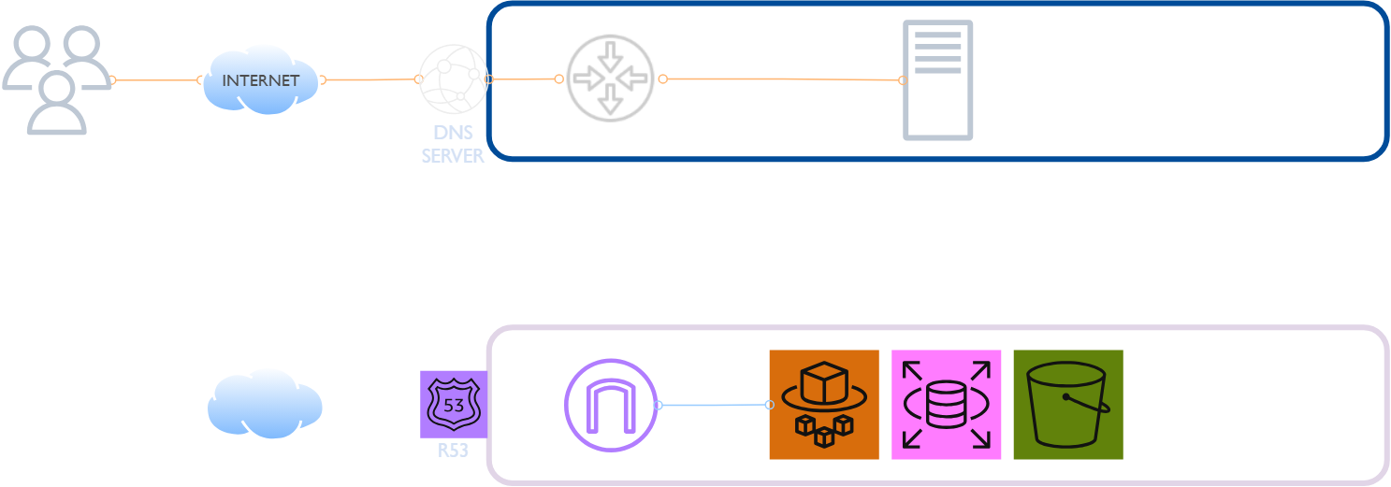
CUTOVER STRATEGY
CANARY RELEASING METHOD
NOTES:
The Canary Releasing method focuses on how to cutover the business logic and DNS once the database and Object storage have both been replicated, synchronized and tested on our target AWS environment,
TESA
Cloud Engineering
27

Slide 28
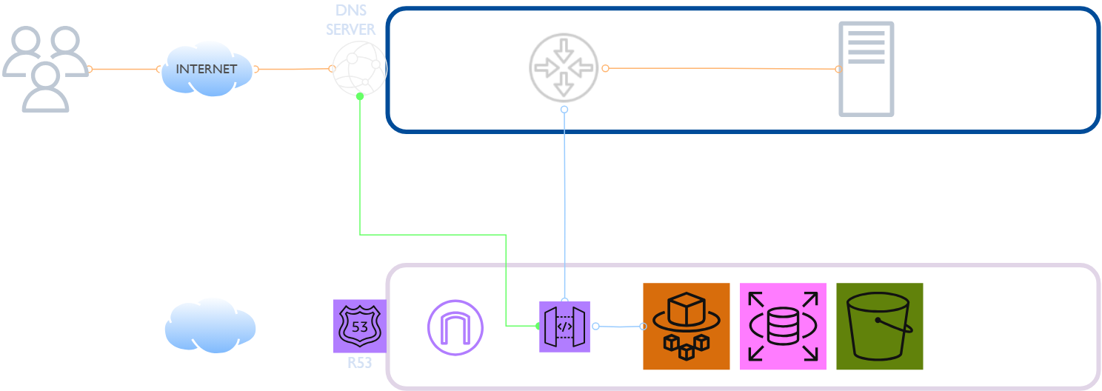
CUTOVER STRATEGY
PHASE 1 – DEPLOY API GATEWAY
NOTES:
API Gateway Set up a proxy or load balancer that will route traffic from the Bluehost DNS to both the old Bluehost infrastructure and our new AWS infrastructure.
Start by routing a small percentage of traffic to our new AWS infrastructure (say 5-10%).
Monitor and test:
Monitor the performance and behavior of the new AWS infrastructure, and test your application thoroughly to ensure everything works as expected.
TESA
Cloud Engineering
28

Slide 29

CUTOVER STRATEGY
PHASE 2 – ROUTE ENTIRE TRAFFIC AFTER TESTING
NOTES:
Gradually increase traffic to AWS Gradually increase the percentage of traffic routed to AWS until all traffic is being routed to the new infrastructure once we are confident in the new setup
TESA
Cloud Engineering
29

Slide 30
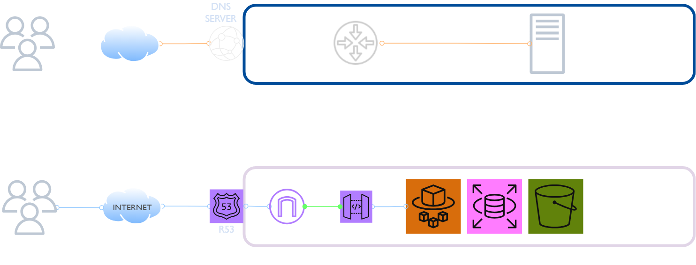
CUTOVER STRATEGY
PHASE 3 – DNS CUTOVER
NOTES:
DNS Cutover Before the final cutover:
Reduce DNS TTL from 24 hours to 5 minutes on Bluehost. This ensures that once we update DNS, clients resolve the new IP quickly.
Ensure database replication is up-to-date.
Verify all student documents are correctly migrated to S3.
Send out final notification 30 mins before final cutover and put website in maintenance mode (i.e. Block public access)
Point domain to API GW and propagate changes on R53.
Best performed at Midnight
TESA
Cloud Engineering
30

Slide 31
HIGH LEVEL PLAN
Migration
DNS Final Cutover
Implementation: Business Logic Cutover, Test and Monitoring
Implement: Storage Synchronization
The Plan will be executed over a span of 4 sprints with well defined goals and deadlines
Implement: Database Synchromization
Establish the Goals
Implement: AWS Setup
Assess Current State
Design Future State
0
2
5
7
9
Sprint 1
Sprint 2
Sprint 3
Sprint 4
TESA
Cloud Engineering
31

Slide 32
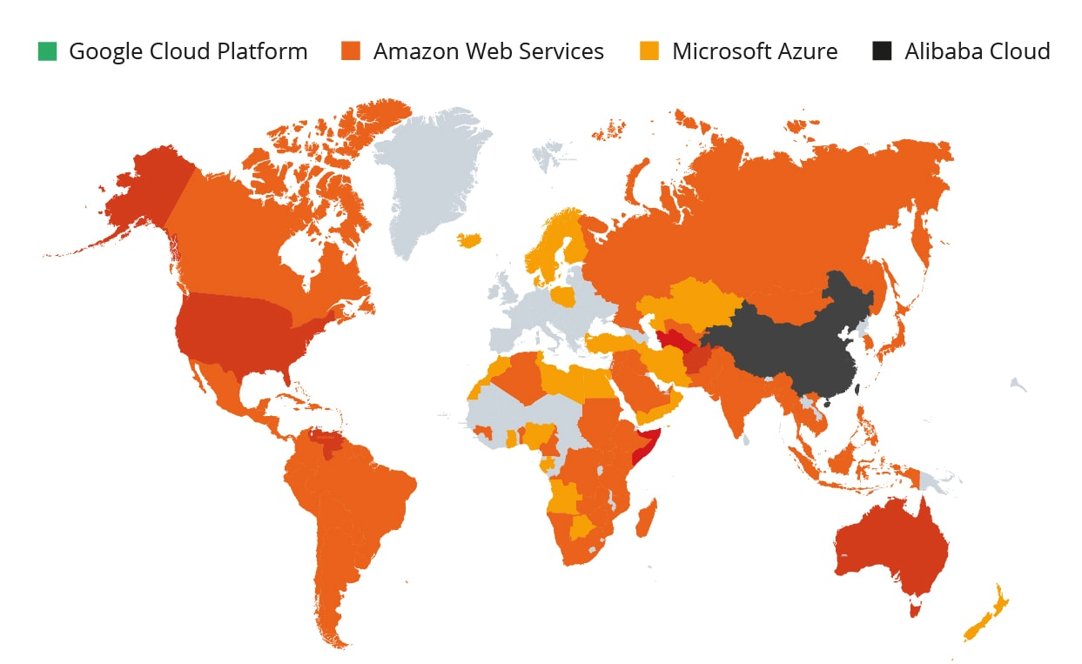






ABOUT US:
LOCATION. SERVICES
England
Canada
U S A
Dubai
QUCOON KEY SERVICES
Qucoon Consulting
Kenya
Qucoon Technology & Engineering Services
Nigeria
Qucoon Plus: Robotics, ML and AI
South Africa
Qucoon Digital Business
Qucoon Studios
Qucoon Cloud
Academy
32

Slide 33
Thank you.
TESA
Cloud Engineering
33

